Slide 1
System Verilog Verification
8-1조
발표자 이준형 | 장현동
2026.03.03

Slide 2
01 | 개요
02 | 목표
03 | 블럭도
04 | Stopwatch
05 | Clock
06 | Uart Fifo
목차

Slide 3
개요
Verification Objective
Stopwatch / Clock 기능 정확성 검증
모듈 간 인터페이스 및 타이밍 검증
SystemVerilog 기반 Self-checking Testbench 구축

Slide 4
목표
Verification Goal
본 프로젝트의 목표는 SystemVerilog 기반 Testbench를 구축하여
UART RX → FIFO & FIFO → UART TX데이터 흐름 검증
FIFO Full/Empty 동작 검증
Baud Rate 기반 UART 타이밍 정확성 검증
Stopwatch 기능 검증 (Start/Stop/Reset)
Clock 시간설정 정확성 검증 을 수행

Slide 5
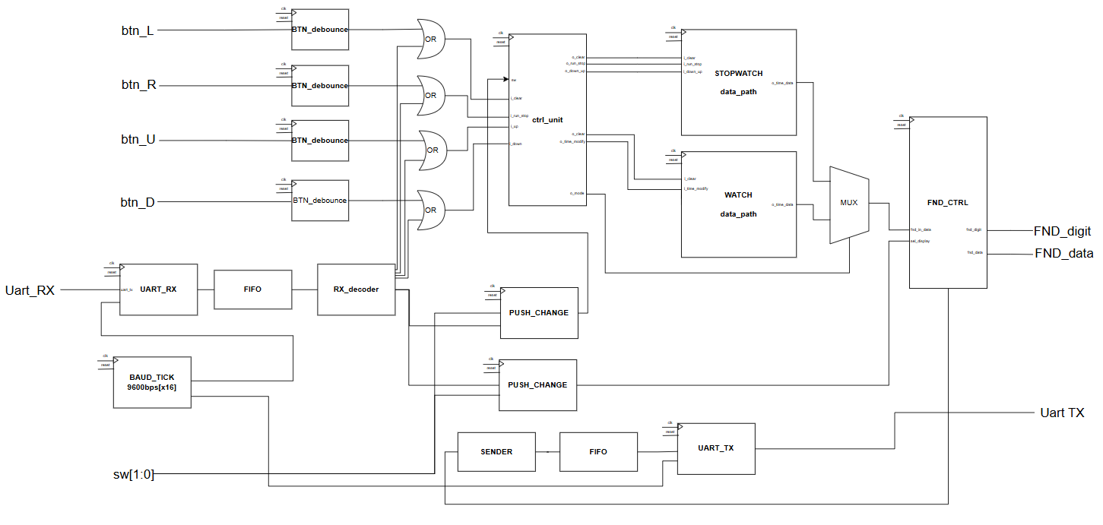
블럭도

Slide 6
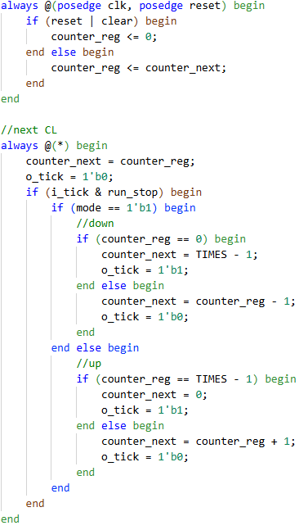
Stopwatch datapath
- stopwatch movement
up
count
1
mode
Down
count
1
0
run
0
Stop
clear
clear

Slide 7
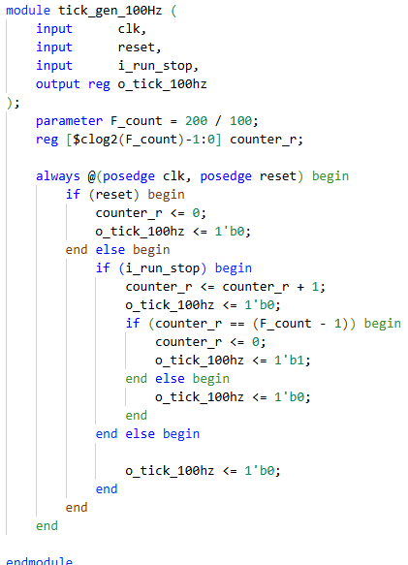
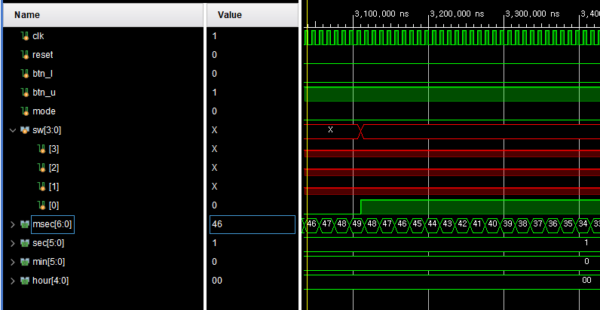
Stopwatch tick gen
100hz -> clk단위로 변경
Fcount = 1,000,000 -> 2
시뮬레이션 시간 50k배 가속
Msec = 2clk 단위

Slide 8
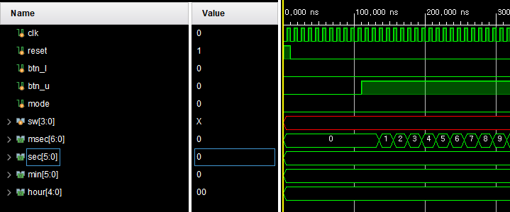
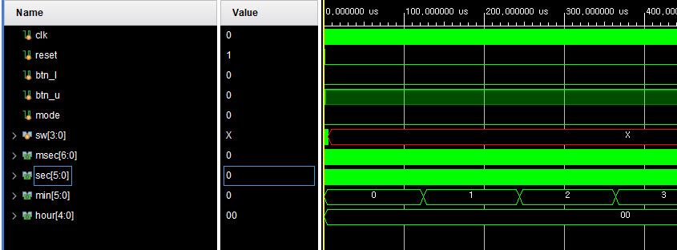
Stopwatch datapath run
run
run

Slide 9
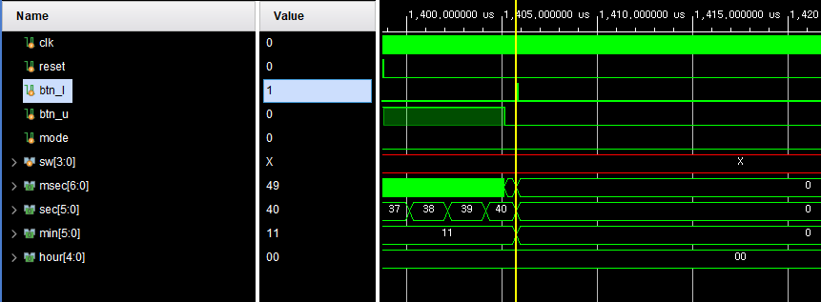
Stopwatch datapath stop / clear
Stop / Clear

Slide 10
Stopwatch datapath sw[0] downcount
mode

Slide 11



Stopwatch Simulate Scenario
01
02
03
randomize
Check run/stop
randomize
Check up/down count
randomize
Check All

Slide 12
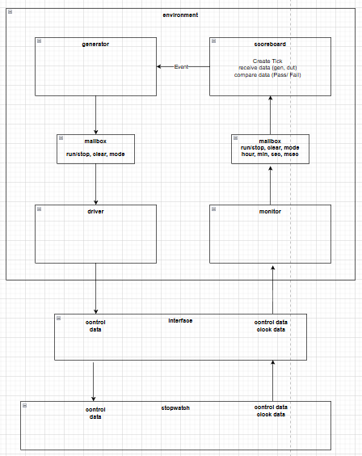
Stopwatch verification Block
run/stop, mode, clear
randomize 생성
기댓값 생성
hour, min, sec, msec
기대값과 dut 출력값을 받아 비교 후 Pass or Fail
이후 gen_next_event
posedge #1
monitor 에서 출력값 샘플해
scorboard로 전달
negedge #4
interface 로 기대값, 입력값 drive

Slide 13
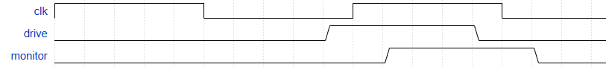
Stopwatch verification timing
Meta stable 영역을 피하기 위함

Slide 14
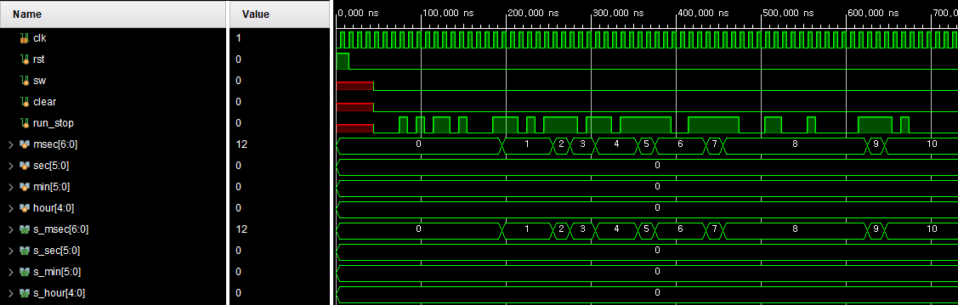
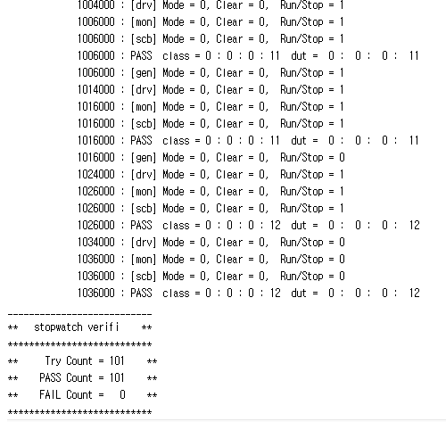
Stopwatch Simulate randomize run / stop
Scorboard 기댓값
Dut 출력
run
run,stop
Tick gen = 2clk 마다 1

Slide 15
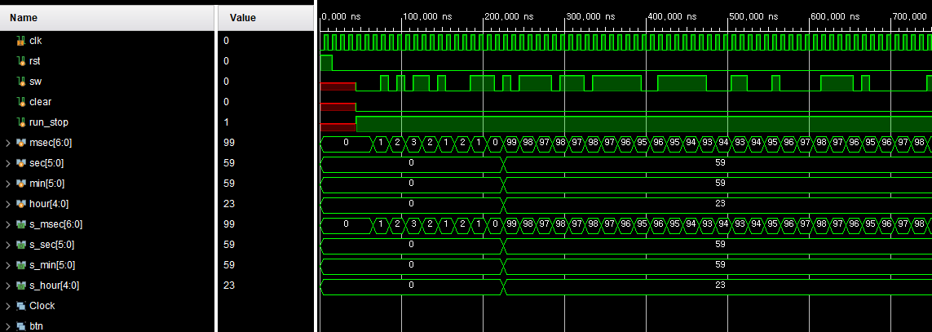
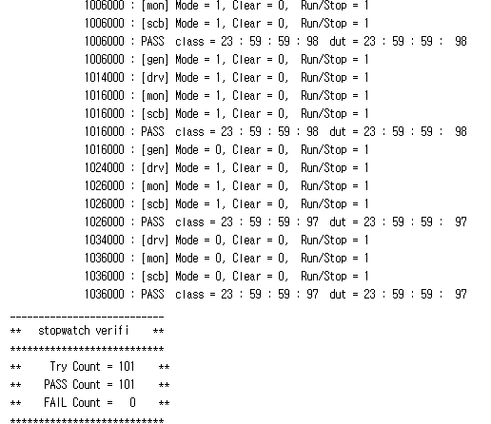
Stopwatch Simulate randomize up/down
Scorboard 기댓값
Dut 출력
Mode 0 up
Mode 1
down

Slide 16
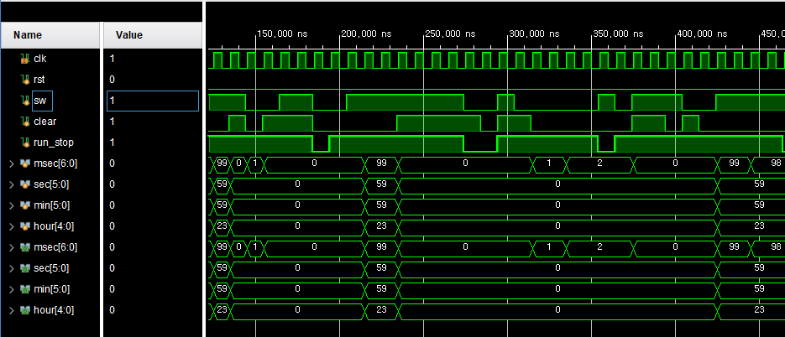
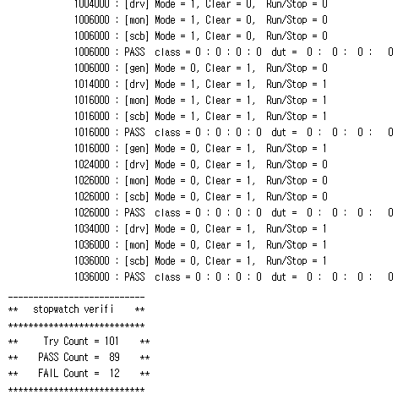
Stopwatch Simulate randomize all
Up/down
Scorboard 기댓값
Dut 출력
Clear
run / stop
Run= 1
down = 1

Slide 17
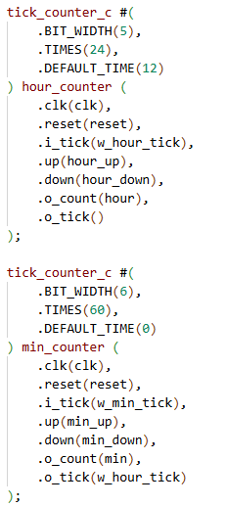
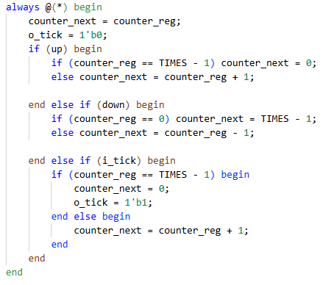
Clock datapath
Clock tick gen
100hz -> clk단위로 변경
단위별 up/down 동작

Slide 18
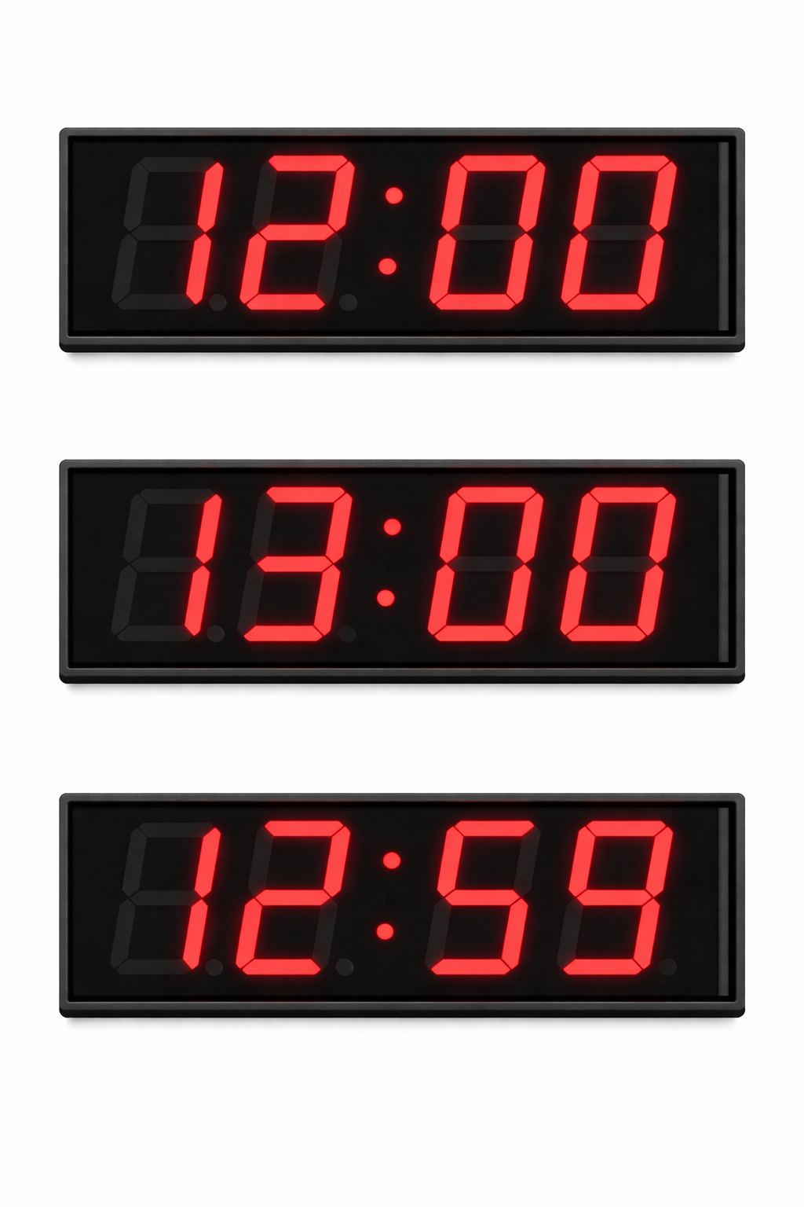
Clock datapath
- up/down setup
Hour Up
Min Down
Setup이 아닌 digit 에 대해 영향 X

Slide 19
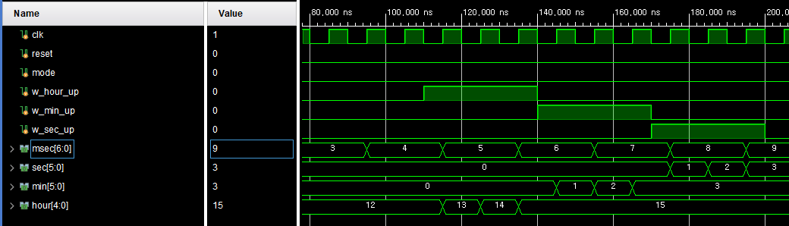
Clock datapath up
Sec up
Min up
Hour up

Slide 20
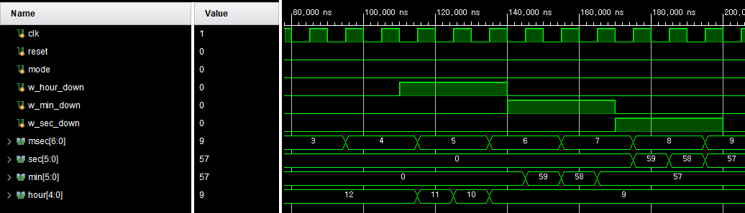
Clock datapath down
Sec down
Min down
Hour down

Slide 21
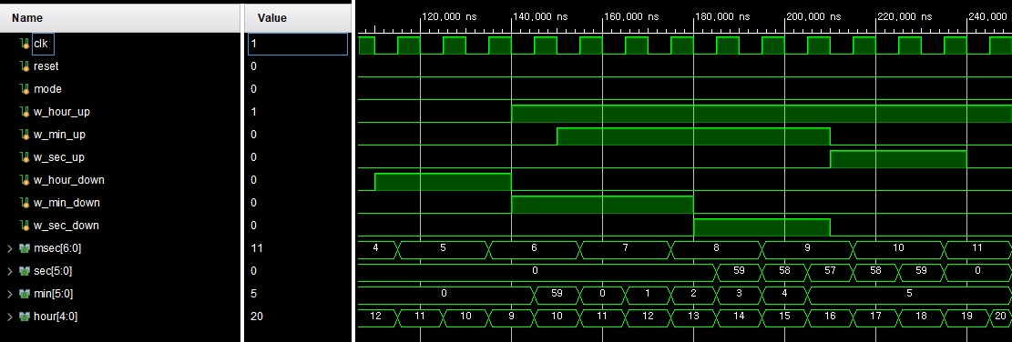
Clock datapath up/down
Up/down 동시입력

Slide 22
Clock Simulate Scenario
01
02
03
Randomize
Check up time
randomioze
Check down time
randomize
Check up / down

Slide 23
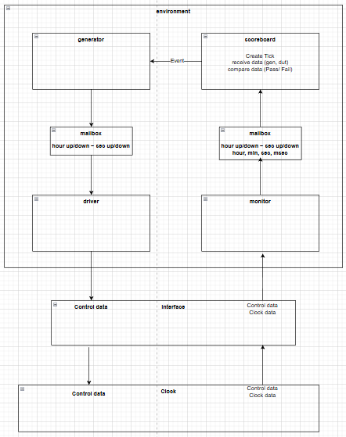
Clock verification Block
hour up/down
min up/down
sec up/down
randomize 생성
기댓값 생성
hour, min, sec, msec
기대값과 dut 출력값을 받아 비교 후 Pass or Fail
이후 gen_next_event
posedge #1
monitor 에서 출력값 샘플해
scorboard로 전달
negedge #4
interface 로 기대값, 입력값 drive

Slide 24
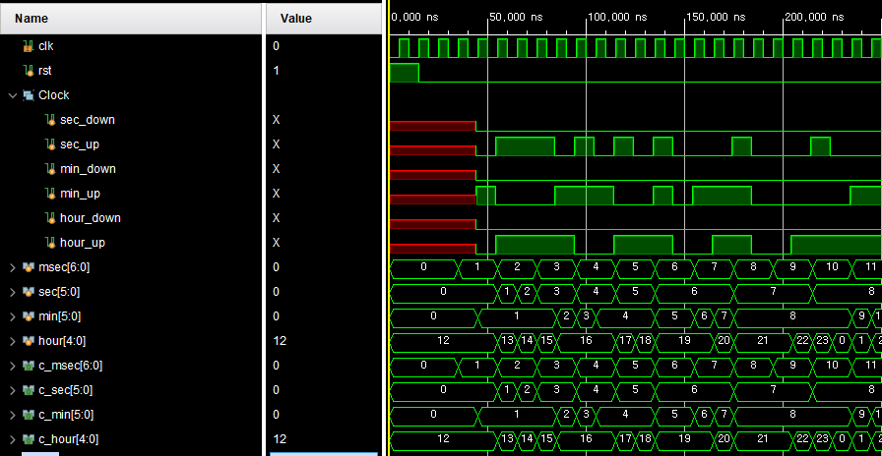
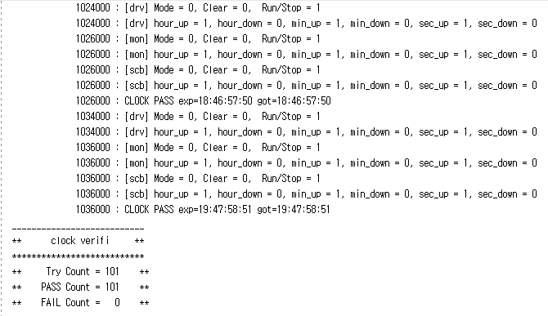
Clock Simulate randomize up
Scorboard 기댓값
Dut 출력
매 clk sec hour
동시 상승 구간
Sec min hour 상승

Slide 25
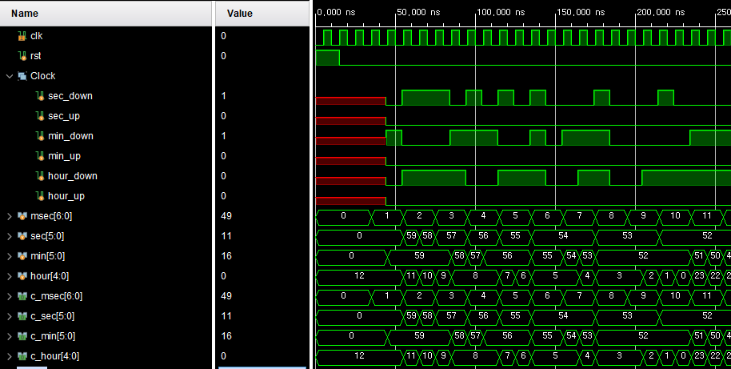
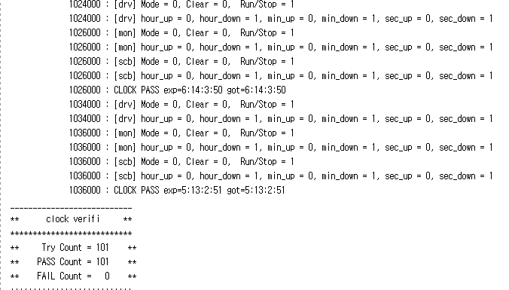
Clock Simulate randomize down
Scorboard 기댓값
Dut 출력
매 clk sec hour
동시 하강 구간
hour min sec 동시 하강

Slide 26
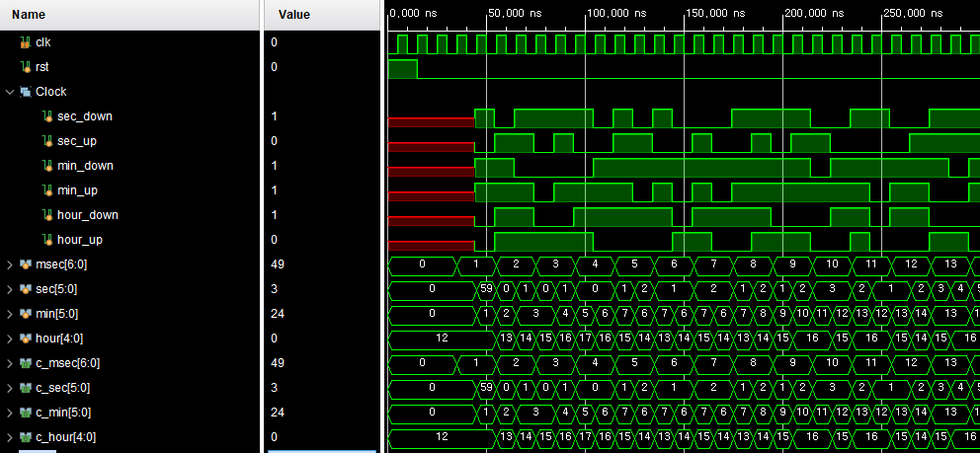
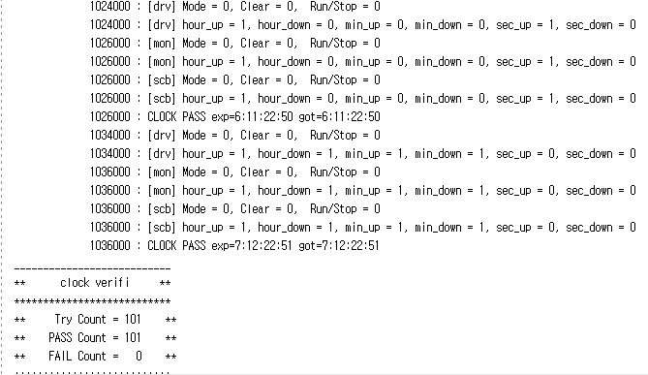
Clock Simulate randomize all
Scorboard 기댓값
Dut 출력
sec = up
min = up/down (up)
hour = up/down (up)
sec = down
min = up / down (up)
Hour = up

Slide 27
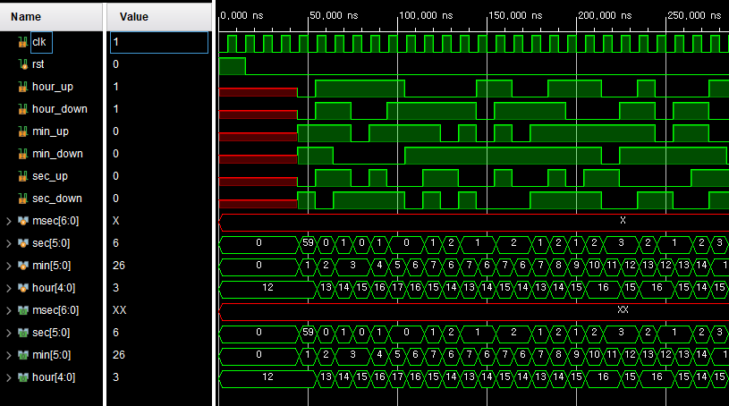
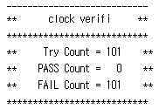
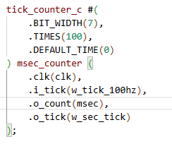
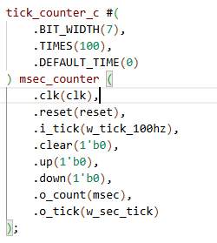
Trouble shooting

Slide 28
FIFO Simulate Scenario
01
02
03
randomize
Only Push/Only Pop
randomize
Push + Pop at the same time
randomize
Push/pop 1000 cycle

Slide 29
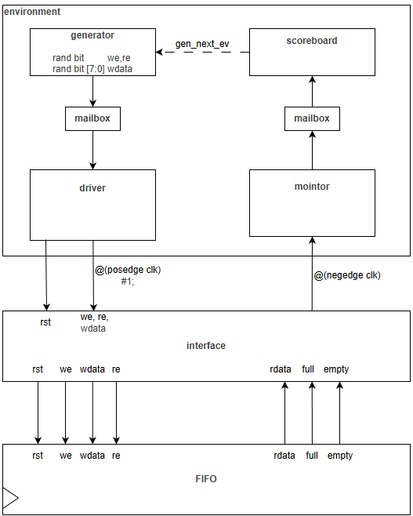
FIFO
Type | name
Rand bit | we
Rand bit | re
Rand bit | wdata
Logic | rdata
bit | full
bit | empty

Slide 30
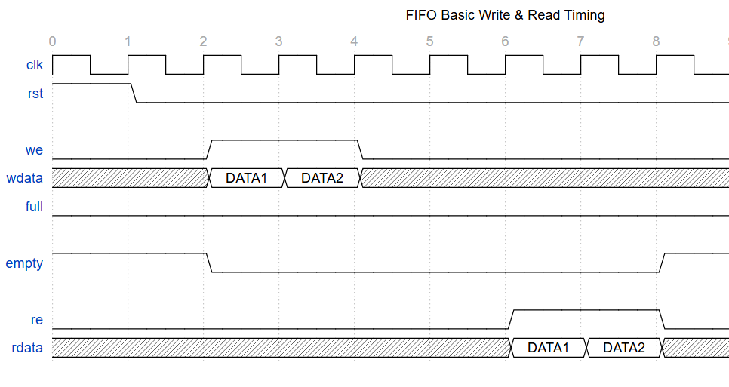
FIFO
driver
monitor

Slide 31
FIFO
wdata
rdata
We && !full
Q list
First input data
T/F
Re && !empty

Slide 32
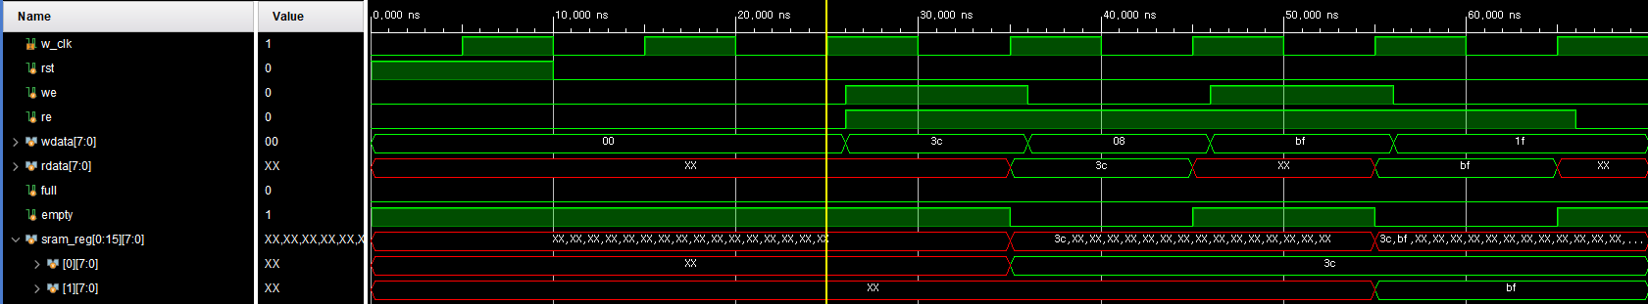
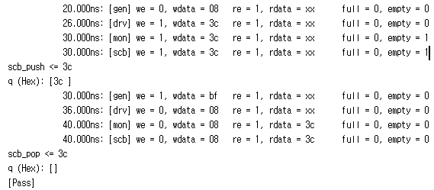
FIFO
- Verification

Slide 33
FIFO
- Verification

Slide 34
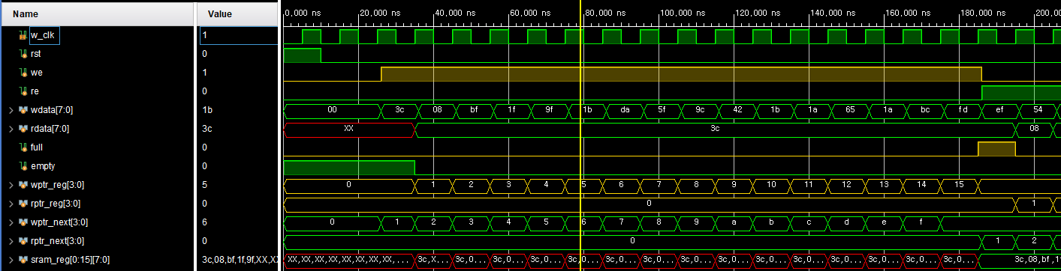
FIFO
- Verification(16번 we)
we -> empty = 0
We -> (wptr_next == rptr_reg) -> full = 1
Re -> full = 0

Slide 35
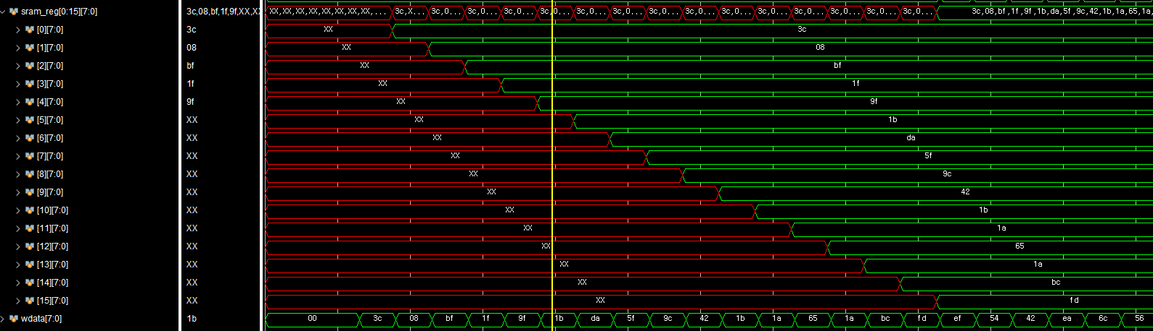
FIFO
- Verification(16번 we)

Slide 36
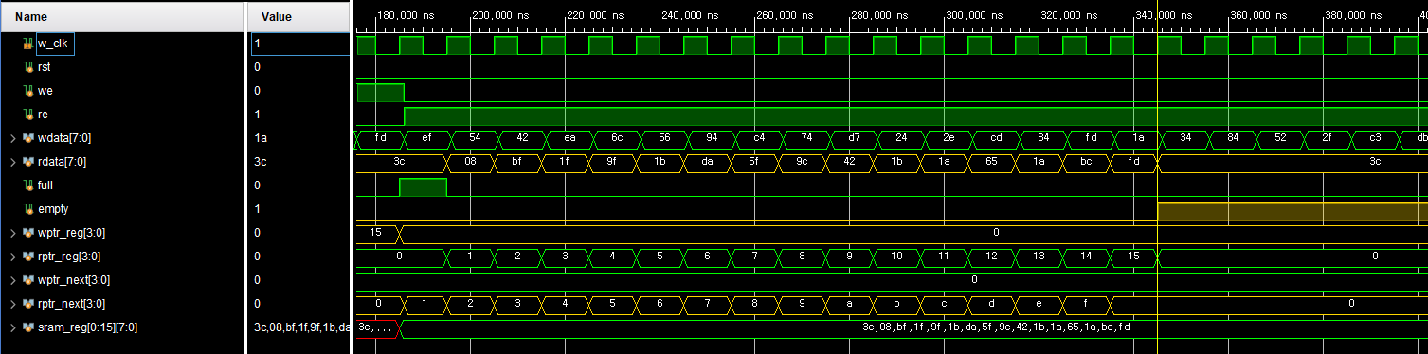
FIFO
- Verification(16번 re)
Re -> (wptr_reg == rptr_next) -> empty = 1

Slide 37
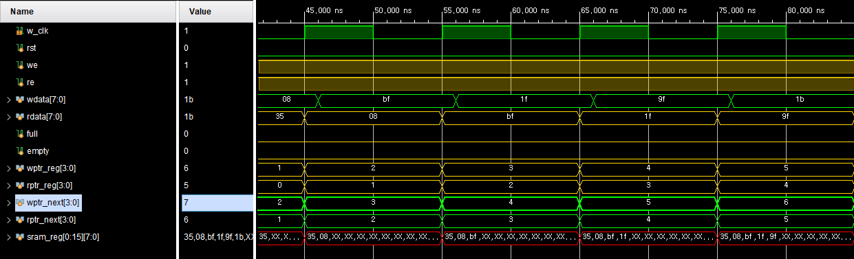
FIFO
- Verification(동시 we= 1, re = 1)
we = 1, re = 1 -> wptr_reg++, rptr_reg++;

Slide 38
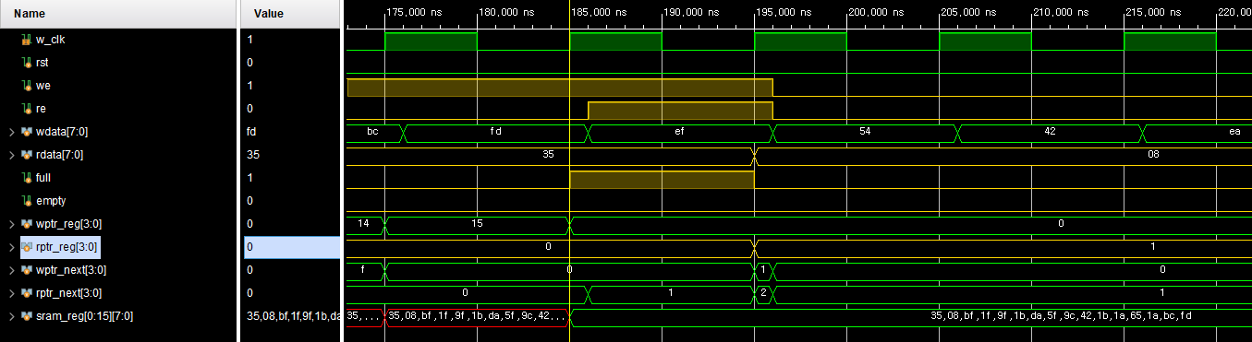
FIFO
- Verification(동시 we= 1, re = 1)
full == 1 상황:
we = 1, re = 1 -> full = 0, rptr_reg++;

Slide 39
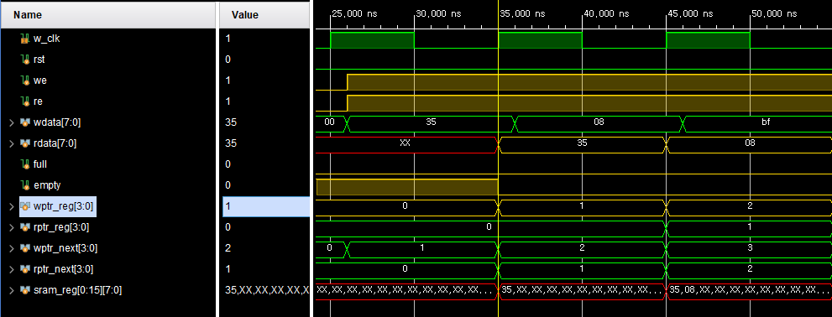
FIFO
- Verification(동시 we= 1, re = 1)
empty == 1 상황:
we = 1, re = 1 -> empty = 0, wptr_reg++;

Slide 40
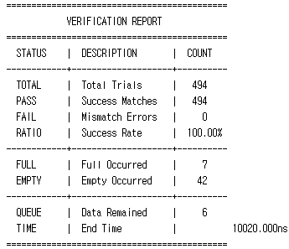
FIFO
- Verification(random 1000 cycle)

Slide 41
RX + FIFO Simulate Scenario
01
02
03
randomize
Run 1 cycle
Check Rx + FIFO data Flow
randomize
Run 1000 cycle
randomize
Baud delay rate Allowable range

Slide 42
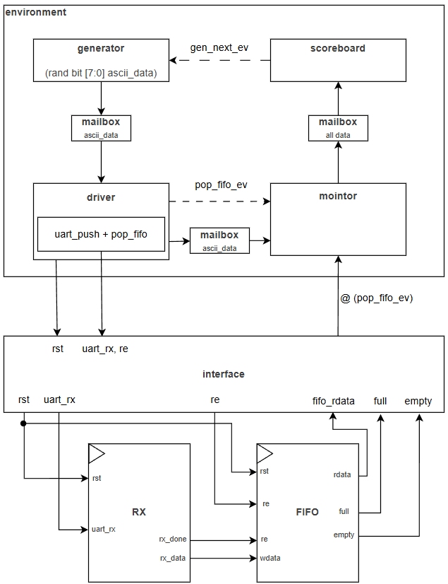
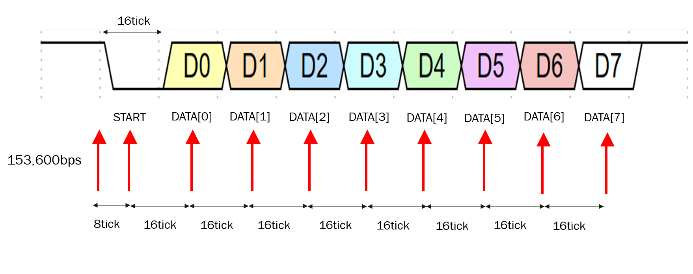
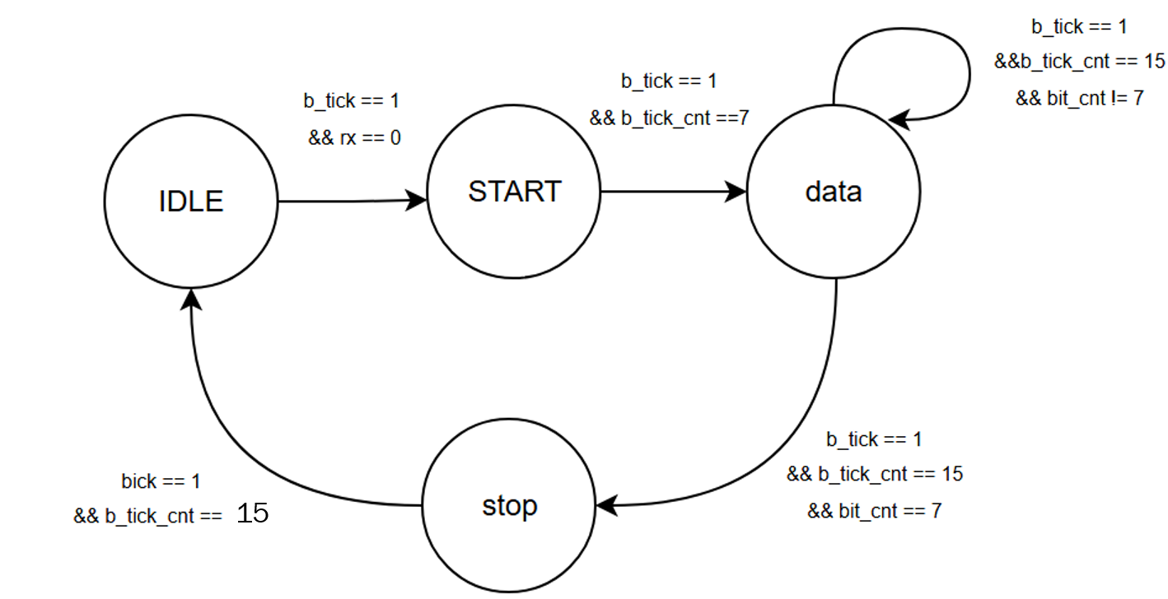
RX + FIFO

Slide 43
RX + FIFO
c
Type | name
Randc bit | ascii_data
bit | re
logic | Fifo_data
bit | full
Bit | empty

Slide 44
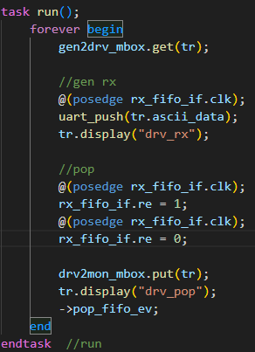
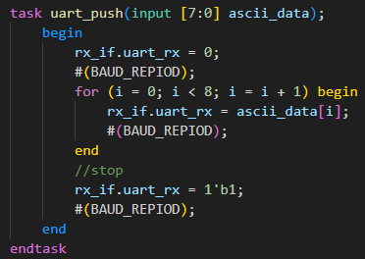
RX + FIFO
BAUD_REPIOD = (100MHz / 9600bpm)*10

Slide 45
RX + FIFO
c
Ascii data + Interface I/O
@(pop_fifo_ev)
mailbox
Scoreboard
ASCII DATA == tr.rx_data

Slide 46
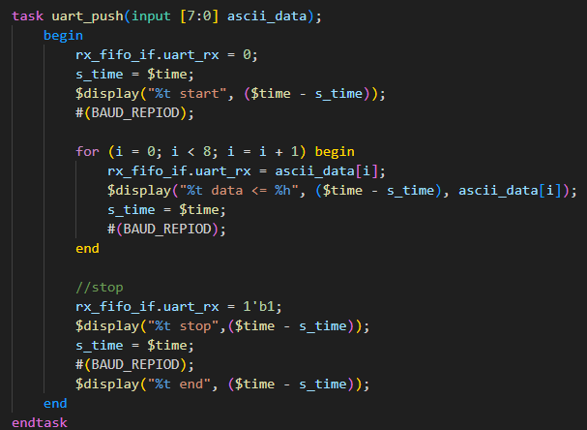
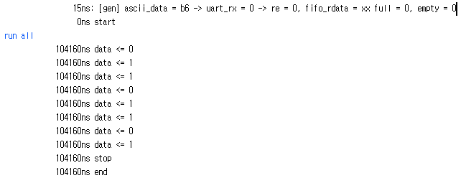
RX + FIFO
- Verification(check gen RX)
BAUD_REPIOD = (100MHz / 9600bpm)*10 = 104160

Slide 47

RX + FIFO
- Verification(check gen RX)
Rx = 10bit * 104160 = 1041600ns = 1041.6us

Slide 48

RX + FIFO
- Verification(module RX)
B_tick = 100Mhz / (9600bps * 16배)= 6.51us

Slide 49

RX + FIFO
- Verification(module RX) input(8’hB6)
START
DATA

Slide 50

RX + FIFO
- Verification(module RX) input(8’hB6)
B_tick_cnt 15마다 buf_reg의 MSB에 반영 및 shift 발생

Slide 51
RX + FIFO
- Verification(module RX) input(8’hB6)
B_tick_cnt 15마다 buf_reg의 MSB에 반영 및 shift 발생

Slide 52

RX + FIFO
- Verification(module RX) input(8’hB6)
(Rx_done == 1) ➔ Rx_data = 8’b6

Slide 53

RX + FIFO
- Verification(RX ➔ FIFO) input(8’hB6)

Slide 54

RX + FIFO
- Verification(RX ➔ FIFO) input(8’hB6)
Rx_done은 uart_rx신호를 다 보내기 전에 발생

Slide 55


RX + FIFO
- Verification(random 1000 clcye)
rx_data 검증 data : 14,22,55,59,85,123,185,209제외된 0~255 data

Slide 56


RX + FIFO
- Verification(missing cases 50 clcye)
rx_data 추가 검증 data : 14,22,55,59,85,123,185,209

Slide 57



RX + FIFO
- Verification(baud delay rate)

Slide 58

RX + FIFO
- Verification(baud delay rate)
Add_rate = 1.0
Add_rate = 1.1

Slide 59
RX + FIFO
- Verification(baud delay rate)
rate | 1.1 | 1.07 | 1.06 | 1.05 | 1.04 | 1.02 | 1.0 | 0.98 | 0.95 | 0.94 | 0.93
Total | 50 | 50 | 50 | 50 | 50 | 50 | 50 | 50 | 50 | 50 | 50
Pass | - | - | - | 50 | 50 | 50 | 50 | 50 | 50 | - | -
fail | 50 | 50 | 50 | - | - | - | - | - | - | 50 | 50
Use Rx_delay rate = 95% ~105%

Slide 60
TX + FIFO Simulate Scenario
01
02
03
randomize
Run 1 cycle
Check Tx + FIFO data Flow
randomize
Run 1000 cycle
randomize
fifo[full] -> continuous output

Slide 61



TX + FIFO

Slide 62
TX + FIFO
c
Type | name
bit | Fifo_we
Randc bit | Fifo_wdata
bit | Tx_busy
bit | Tx_done
bit | Uart_Tx
bit | PC_data

Slide 63

TX + FIFO
c

Slide 64

TX + FIFO
c
BAUD/2 + BAUD
BAUD
BAUD
BAUD
BAUD
BAUD
BAUD
BAUD
BAUD * 8cycle

Slide 65

TX + FIFO
c

Slide 66

TX + FIFO
- Verification(TX) input(8’hB6)
Generate wdata
Tx_read data

Slide 67

TX + FIFO
- Verification(FIFO ➔ TX) input(8’hB6)
We==1 Re==1 ➔ rdata = b6,empty = 0 ➔ tx_start = 1

Slide 68

TX + FIFO
- Verification(TX) input(8’hB6)
Uart_tx = 0
Save tx_data

Slide 69

TX + FIFO
- Verification(TX) input(8’hB6)
B_tick 발생 ➔ bt_cnt16_reg ++

Slide 70

TX + FIFO
- Verification(TX) input(8’hB6)
START
DATA

Slide 71
TX + FIFO
- Verification(TX) input(8’hB6)
START
DATA

Slide 72

TX + FIFO
- Verification(TX) input(8’hB6)
START
DATA
STOP
DATA bit별 send time = 104.16us
STOP bt send time = 104.16us

Slide 73

TX + FIFO
- Verification(TX) input(8’hB6)
STOP
IDLE
(STOP -> IDLE) ➔ done 1 tick 발생 및 busy = 0

Slide 74


TX + FIFO
- Verification(random 1000 cycle)

Slide 75
TX + FIFO
- Verification(random 1000 cycle)

Slide 76

TX + FIFO
- Verification(random 1000 cycle)
rx_data 검증 data : 18,246,223

Slide 77


TX + FIFO
- Verification(fifo[full] -> continuous output)

Slide 78

TX + FIFO
- Verification(fifo[full] -> continuous output)

Slide 79


Troubleshooting
RX + FIFO (uart_push 후 FIFO rdata를 read 해야할 상황)
문제: Empty == 0 일때, pop 수행하려 시도 하였지만 re 발생 하지 않음
원인: uart_push와 wait 타이밍의 문제
해결: wait 동작을 거치지 않고 uart_push task가 끝나면 read 진행

